Slide 1
Introductie Neurale Netwerken
Bart Bozon
S4

Slide 2

https://www.bcm.edu/news/deep-neural-networks-uncover-what-brains-likes-to-see

Slide 3
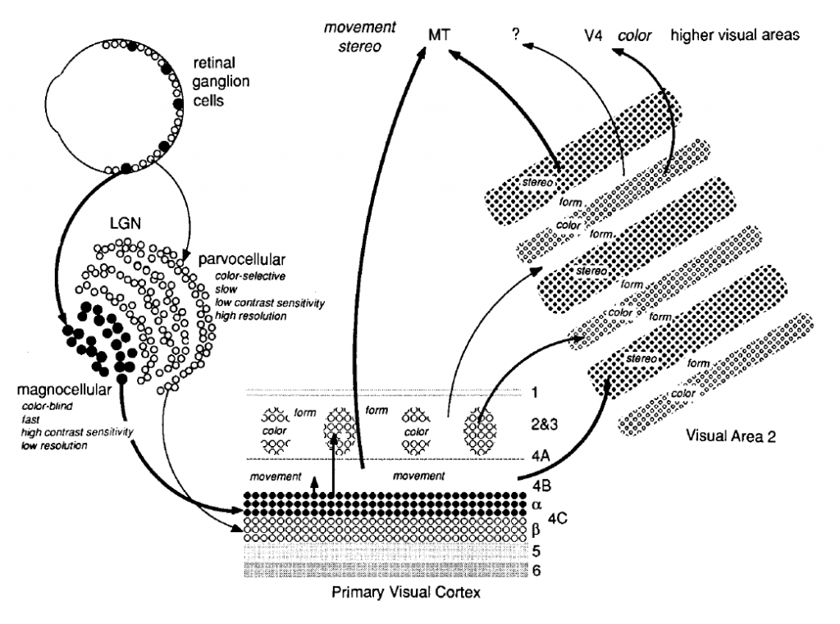
https://www.brainhq.com/brain-resources/brain-facts-myths/how-vision-works

Slide 4


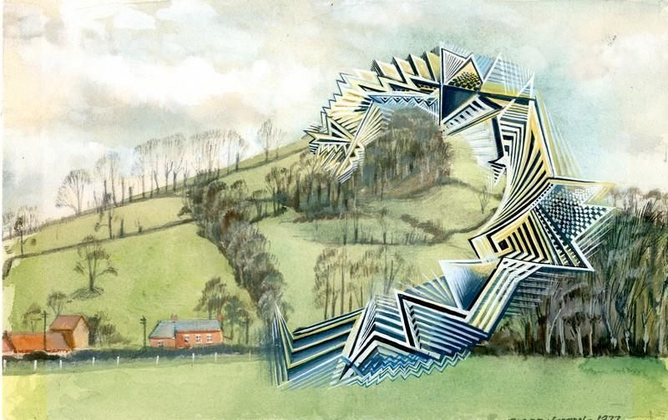
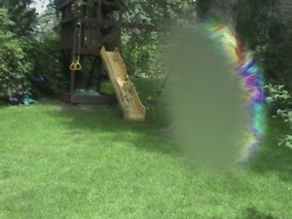

Slide 5


Slide 6
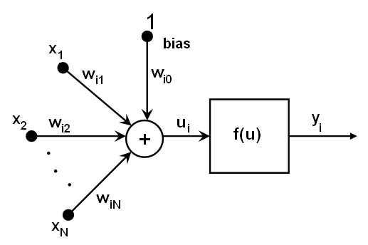
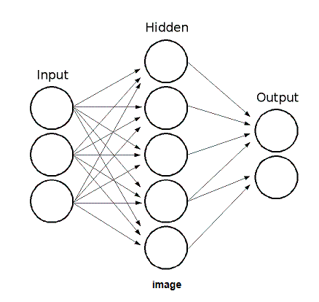

Slide 7
XOR function
Input A | Input B | Output
1 | 1 | 0
0 | 1 | 1
1 | 0 | 1
0 | 0 | 0

Slide 8
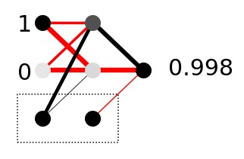
XOR function
Input A | Input B | Output
1 | 1 | 0
0 | 1 | 1
1 | 0 | 1
0 | 0 | 0

Slide 10
Input
layer

Slide 11
Hidden
layer
Input
layer

Slide 12
Hidden
layer
Input
layer
Output
layer

Slide 13
Hidden
layer
Input
layer
Output
layer
Bias

Slide 14
Hidden
layer
Input
layer
Output
layer
Weights
Bias

Slide 15
Hidden
layer
Input
layer
Output
layer
Weights
Bias

Slide 20
1 x -1.73 = -1.73

Slide 21
1 x -1.73 = -1.73

Slide 22
1 x -1.73 = -1.73
0 x -1.72 = 0

Slide 23
1 x -1.73 = -1.73
0 x -1.72 = 0

Slide 24
weights
nodes
1 x -1.73 = -1.73
0 x -1.72 = 0
1 x 2.33 = 2.33
bias

Slide 25
weights
nodes
1 x -1.73 = -1.73
0 x -1.72 = 0
1 x 2.33 = 2.33
0.61

Slide 26
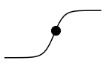
1
0.60
0
weights
-10
10
nodes
0.61
1 x -1.73 = -1.73
0 x -1.72 = 0
1 x 2.33 = 2.33
0.61

Slide 27
1
0.60
0
weights
-10
10
nodes
0.61
1 x -1.73 = -1.73
0 x -1.72 = 0
1 x 2.33 = 2.33
0.61

Slide 28
0.60
weights
nodes
0.61
1 x -1.73 = -1.73
0 x -1.72 = 0
1 x 2.33 = 2.33
0.61
1 x -3.24 = -3.24
0 x -3.20 = 0
1 x 0.41 = 0.41
-2.83

Slide 29
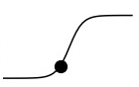
0.60
0.61
1 x -1.73 = -1.73
0 x -1.72 = 0
1 x 2.33 = 2.33
0.61
1 x -3.24 = -3.24
0 x -3.20 = 0
1 x 0.41 = 0.41
-2.83
0.00
-2.83

Slide 30
0.60
0.00

Slide 31
0.60
0.00

Slide 32
0.60
0.6 x 2.91 = 1.7
0.00

Slide 33
0.60
0.6 x 2.91 = 1.7
0.00

Slide 34
0.60
0.6 x 2.91 = 1.7
0.0 x -3.24 = 0
0.00

Slide 35
0.60
0.6 x 2.91 = 1.7
0.0 x -3.24 = 0
0.00

Slide 36
weights
nodes
0.60
0.6 x 2.91 = 1.7
0.0 x -3.24 = 0
0.00
1.0 x -0.7 = -0.7
0.998

Slide 39
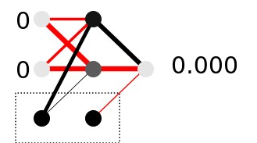

Slide 41
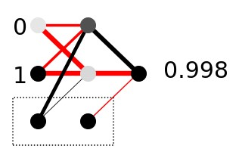

Slide 43
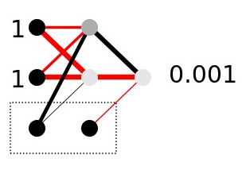

Slide 45
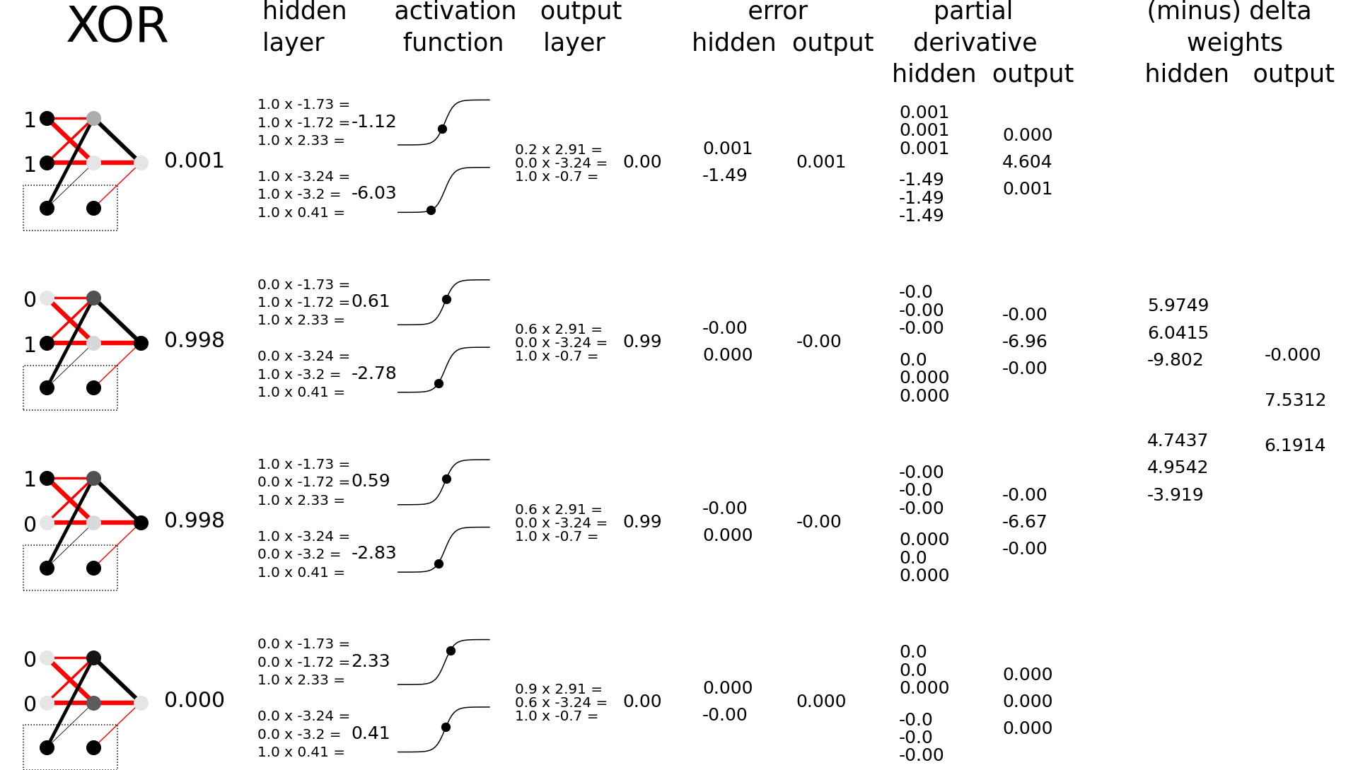

Slide 53
Training the network?

Slide 54
Training a Neural Network
@ Bart Bozon

Slide 55

Trained

Slide 56
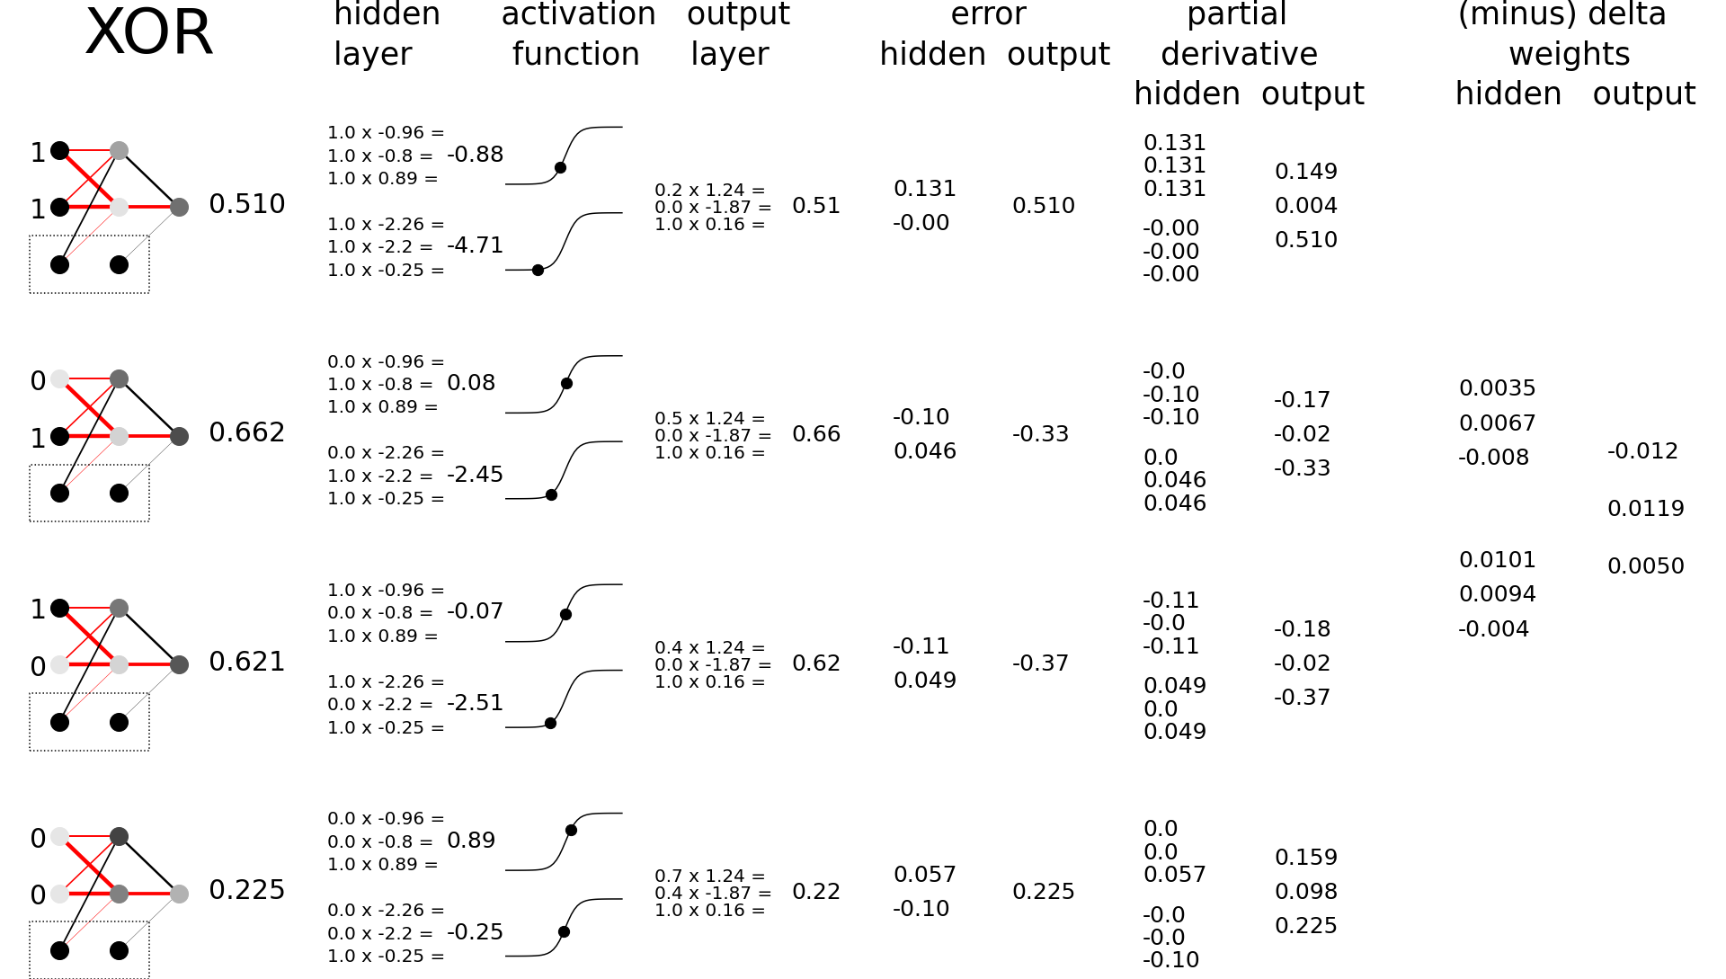
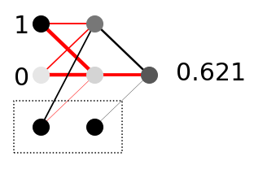
Untrained

Slide 59
How do we change the weights to reduce the error?
Backpropagation!

Slide 60
Let’s start at the back!
Which change in weights is the most useful?
Effect of 0.1 change in weights?
nodes_{hidden}
weights
nodes
0.42 x 1.24 = 0.52
0.42 x 0.1 = 0.042
0.03 x -1.87 = -0.06
0.03 x 0.1 = 0.003
1.00 x 0.16 = 0.16
1.00 x 0.1 = 0.100
Error
-0.38
0.62
How much do we need to change the weight (and which direction)?
Δ_{weight} = - learning_rate x node_{hidden} x error_{output}

Slide 61
Δ_{weight} = - learning_rate x node_{hidden} x error_{output}
learning rate
nodes
_{hidden}
error
_{output}
Δ_{weight}
0.42 x 1.24 = 0.52
-0.25 x 0.42 x -0.38 = 0.039
0.03 x -1.87 = -0.06
-0.25 x 0.03 x -0.38 = 0.003
1.00 x 0.16 = 0.16
-0.25 x 1.00 x -0.38 = 0.095
0.62
Error
-0.38

Slide 62
Δ_{weight} = - learning_rate x node_{hidden} x error_{output}
learning rate
nodes
_{hidden}
error
_{output}
Δ_{weight}
0.42 x 1.24 = 0.52
-0.25 x 0.42 x -0.38 = 0.039
0.03 x -1.87 = -0.06
-0.25 x 0.03 x -0.38 = 0.003
1.00 x 0.16 = 0.16
-0.25 x 1.00 x -0.38 = 0.095
0.62
Error
-0.38

Slide 63
Δ_{weight} = - learning_rate x node_{hidden} x error_{output}
learning rate
nodes
_{hidden}
error
_{output}
Δ_{weight}
0.42 x 1.28 = 0.53
-0.25 x 0.42 x -0.38 = 0.039
0.03 x -1.87 = -0.06
-0.25 x 0.03 x -0.38 = 0.003
1.00 x 0.16 = 0.16
-0.25 x 1.00 x -0.38 = 0.095
0.62
Error
-0.38

Slide 64
Δ_{weight} = - learning_rate x node_{hidden} x error_{output}
learning rate
nodes
_{hidden}
error
_{output}
Δ_{weight}
0.42 x 1.28 = 0.53
-0.25 x 0.42 x -0.38 = 0.039
0.03 x -1.86 = -0.06
-0.25 x 0.03 x -0.38 = 0.003
1.00 x 0.16 = 0.16
-0.25 x 1.00 x -0.38 = 0.095
0.62
Error
-0.38

Slide 65
Δ_{weight} = - learning_rate x node_{hidden} x error_{output}
learning rate
nodes
_{hidden}
error
_{output}
Δ_{weight}
0.42 x 1.28 = 0.53
-0.25 x 0.42 x -0.38 = 0.039
0.03 x -1.86 = -0.06
-0.25 x 0.03 x -0.38 = 0.003
1.00 x 0.25 = 0.25
-0.25 x 1.00 x -0.38 = 0.095
0.62
Error
-0.38

Slide 66
Δ_{weight} = - learning_rate x node_{hidden} x error_{output}
learning rate
nodes
_{hidden}
error
_{output}
Δ_{weight}
0.42 x 1.28 = 0.53
-0.25 x 0.42 x -0.38 = 0.039
0.03 x -1.86 = -0.06
-0.25 x 0.03 x -0.38 = 0.003
1.00 x 0.25 = 0.25
-0.25 x 1.00 x -0.38 = 0.095
0.72
Error
-0.38

Slide 67
Δ_{weight} = - learning_rate x node_{hidden} x error_{output}
learning rate
nodes
_{hidden}
error
_{output}
Δ_{weight}
0.42 x 1.28 = 0.53
-0.25 x 0.42 x -0.38 = 0.039
0.03 x -1.86 = -0.06
-0.25 x 0.03 x -0.38 = 0.003
1.00 x 0.25 = 0.25
-0.25 x 1.00 x -0.38 = 0.095
0.72
Error
-0.38
Error
-0.28

Slide 68
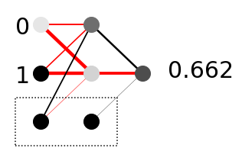
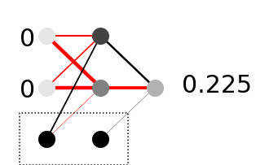
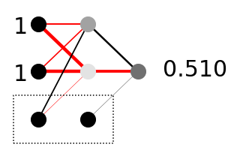
Δ_{weight} = - learning_rate x node_{hidden} x error_{output}

Slide 69
Δ_{weight} = - learning_rate x node_{hidden} x error_{output}

Slide 70
Δ_{weight} = - learning_rate x node_{hidden} x error_{output}
We only trained these weights…

Slide 71
Δ_{weight} = - learning_rate x node_{hidden} x error_{output}
How do we train these weights?

Slide 72
Δ_{weight} = - learning_rate x node_{hidden} x error_{output}
Let’s look at how we would like the hidden nodes to change
Ideally, we would like this one to be higher
(as the output needs to be higher)
And this one to be lower
(as it is negatively connected!)
So both :
1)error_{output}
and how the hidden node is connected to the output:
2)weight_{hidden->output}
are important

Slide 73
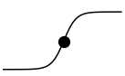
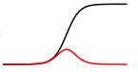
Δ_{weight} = - learning_rate x node_{hidden} x error_{output}
error_{output}
weight_{hidden->output}
But we also have to take the activation function into account!
Changing the input here has almost no effect
Idem
So we use the derivative of the activation function!

Slide 74
Δ_{weight} = - learning_rate x node_{hidden} x error_{output}
error_{output}
weight_{hidden->output}
derivative of the activation function

Slide 75
Δ_{weight} = - learning_rate x node_{hidden} x error_{output}
error_{hidden} = derivative activation function x weight_{hidden->output} x error_{output}

Slide 76
Δ_{weight} = - learning_rate x node_{hidden} x error_{output}
error_{hidden} = derivative activation function x weight_{hidden->output} x error_{output}
der
_{act.func.}
weights
_{hidden->output}
error
_{output}
error
_{hidden}
0.064 x 1.24 x -0.37 = -0.110
0.070 x -1.87 x -0.37 = 0.049

Slide 77
Δ_{weight} = - learning_rate x node_{hidden} x error_{output}
error_{hidden} = derivative activation function x weight_{hidden->output} x error_{output}
-0.110
-0.37
0.049

Slide 78
Δ_{weight} = - learning_rate x node_{hidden} x error_{output}
error_{hidden} = derivative activation function x weight_{hidden->output} x error_{output}

Slide 79
Δ_{weight} = - learning_rate x node_{hidden} x error_{output}
error_{hidden} = derivative activation function x weight_{hidden->output} x error_{output}
Δ_{weight_input->hidden} = - learning_rate x node_{input} x error_{hidden}

Slide 80
Δ_{weight} = - learning_rate x node_{hidden} x error_{output}
error_{hidden} = derivative activation function x weight_{hidden->output} x error_{output}
Δ_{weight_input->hidden} = - learning_rate x node_{input} x error_{hidden}
More layers? Same procedure!

Slide 81
Training a Neural Network II
@ Bart Bozon

Slide 82
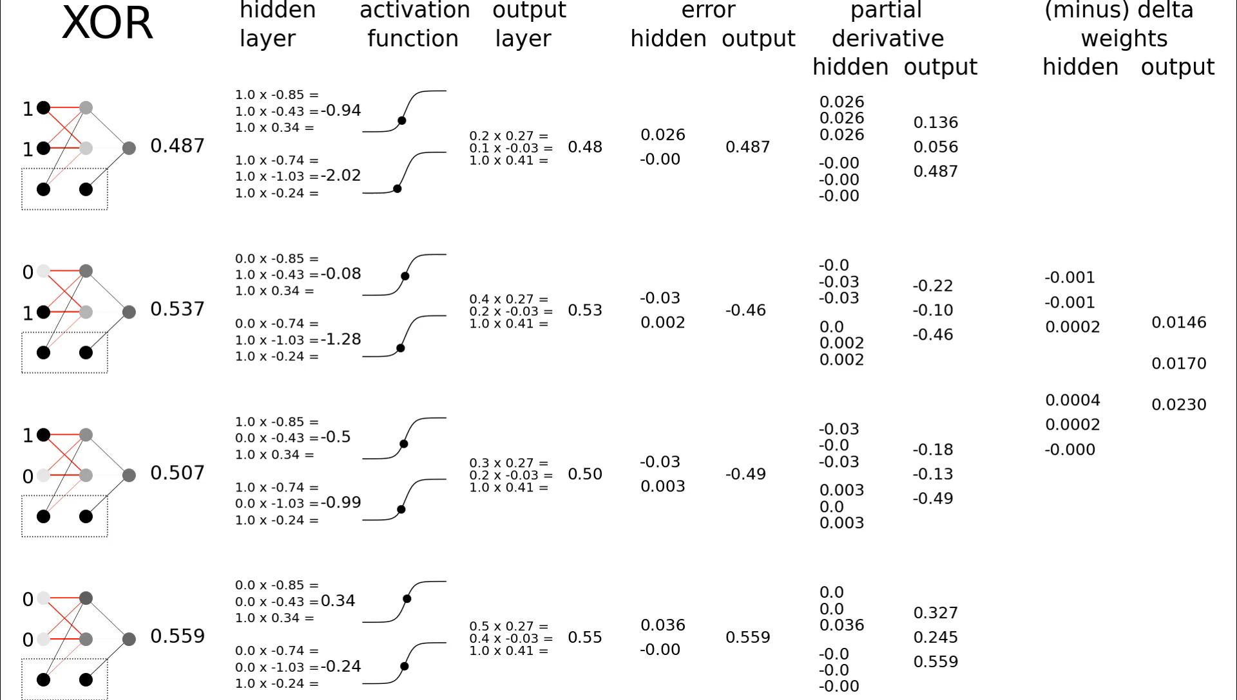

Slide 83
Training a Neural Network III
@ Bart Bozon

Slide 84
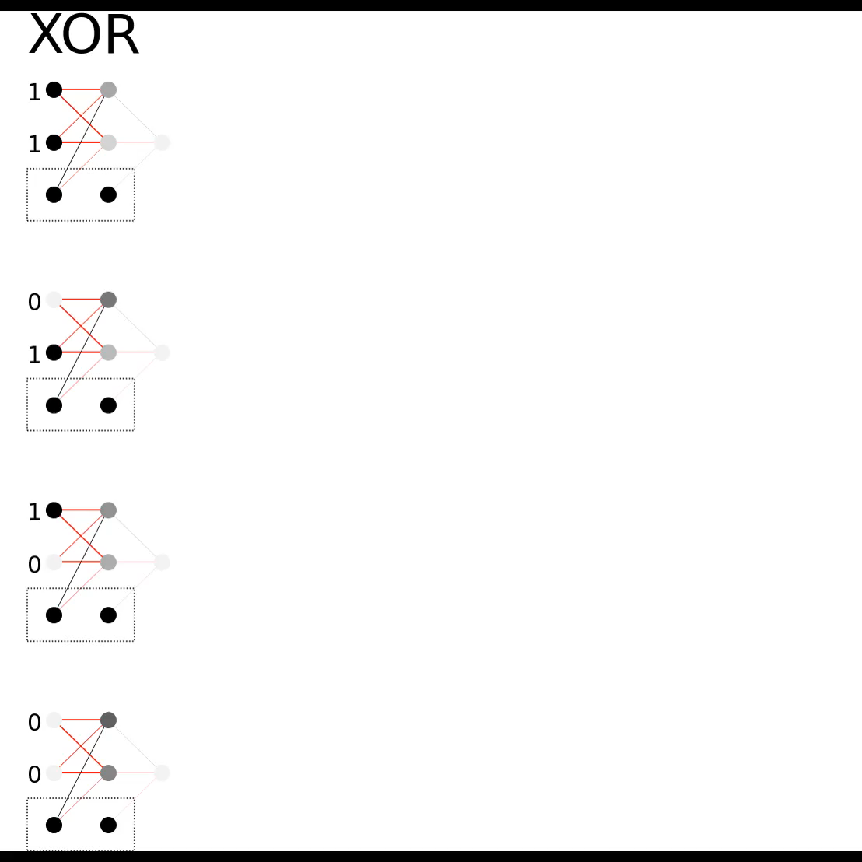

Slide 85
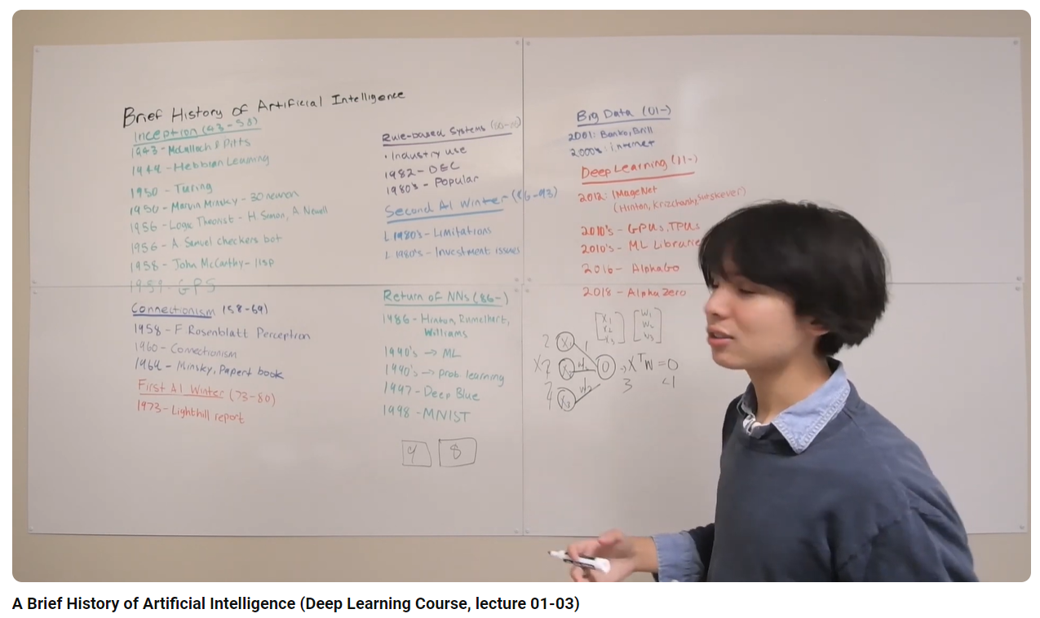
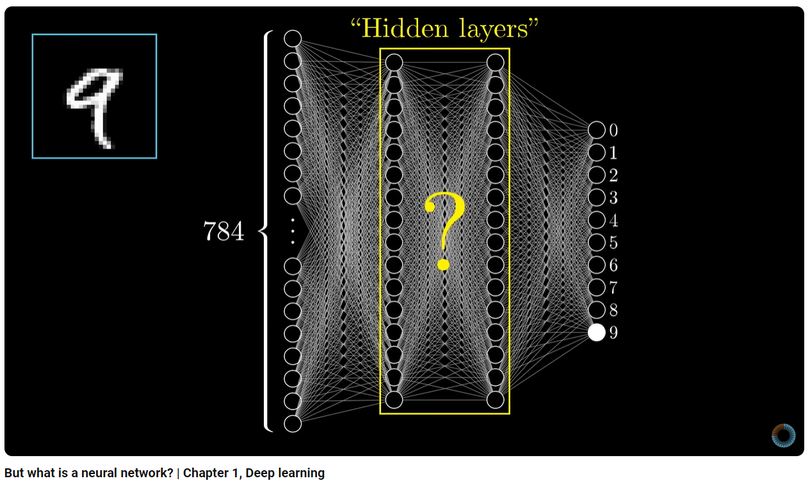
Neural Network
@ 3Blue 1Brown
@ Adam Dhalla
https://youtu.be/OKAIiNoAb64?si=l8iQmtiHLJwioqpA
https://youtu.be/aircAruvnKk?si=762NYNmbHL44sA14

Slide 86
Thank you for your attention!
Any questions?

Slide 87
Optional....

Slide 88
Neural Network Gradient descent
@ Bart Bozon

Slide 89
RMSE
Root Mean Square Error
0.510 – 0 = 0.510
0.662 – 1 = -0.338
0.621 – 1 = -0.379
0.225 – 0 = 0.225

Slide 90
RMSE
0.510 – 0 = 0.510
0.662 – 1 = -0.338
0.621 – 1 = -0.379
0.510² + 0.338² + 0.379² + 0.225²
0.225 – 0 = 0.225

Slide 91
RMSE
0.510 – 0 = 0.510
0.662 – 1 = 0.338
0.621 – 1 = 0.379
0.510² + 0.338² + 0.379² + 0.225²
4
0.225 – 0 = 0.225

Slide 92
RMSE
0.510 – 0 = 0.510
0.662 – 1 = 0.338
0.621 – 1 = 0.379
0.510² + 0.338² + 0.379² + 0.225²
= 0.241
4
0.225 – 0 = 0.225

Slide 93
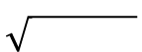
RMSE
= 0.241

Slide 94
RMSE
= 0.490

Slide 95
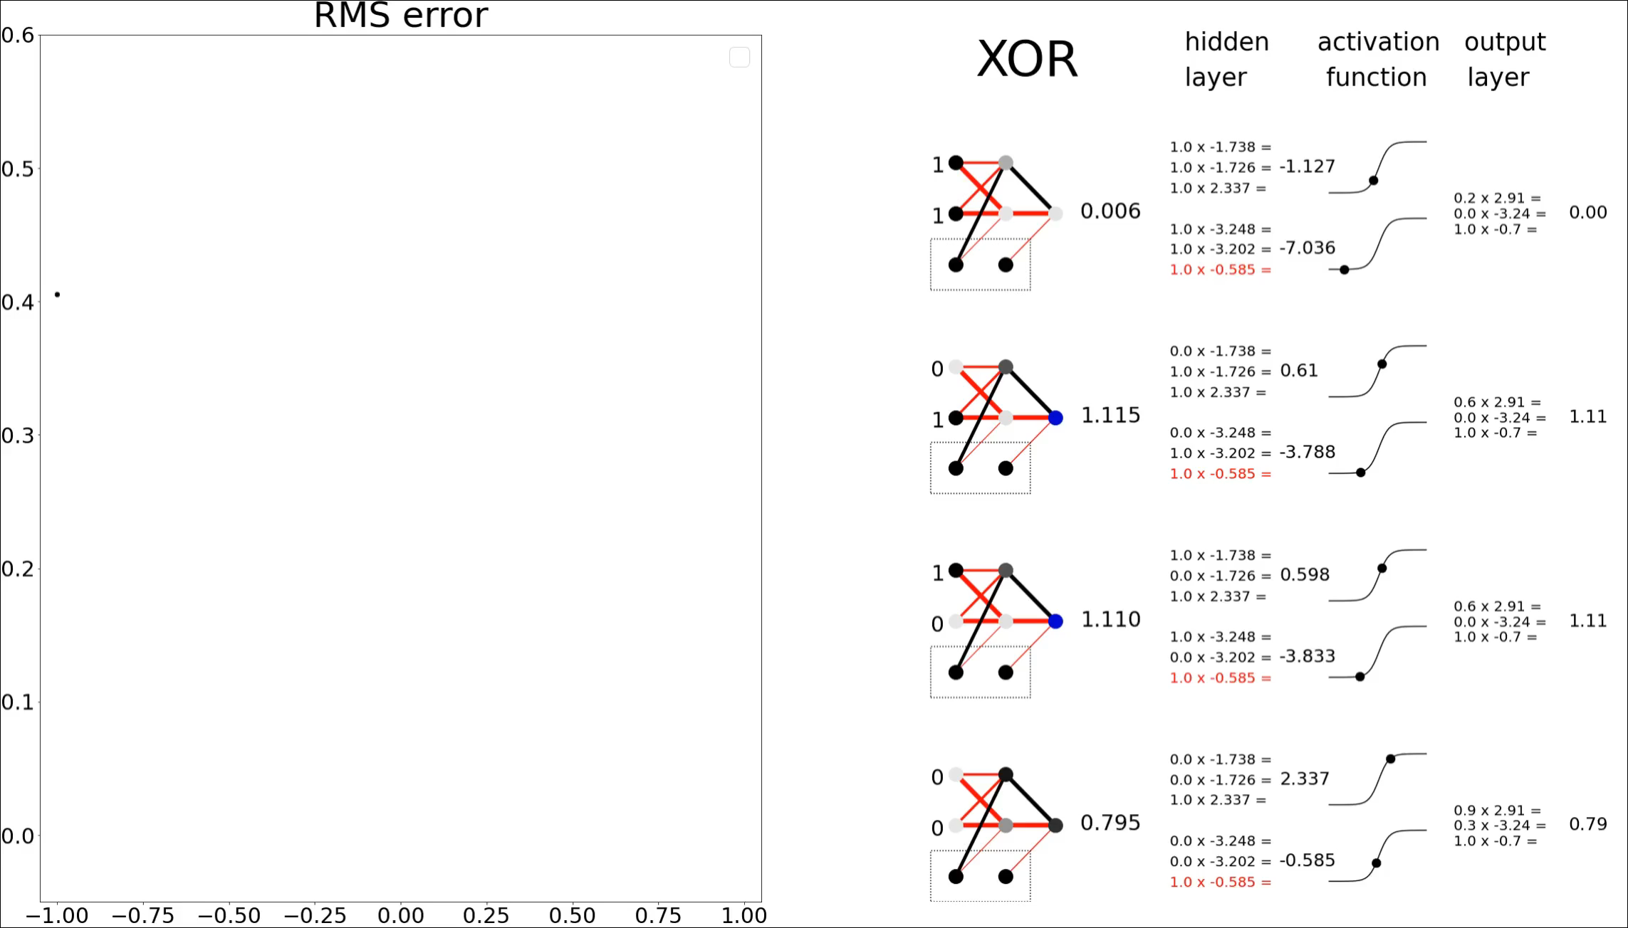

Slide 96
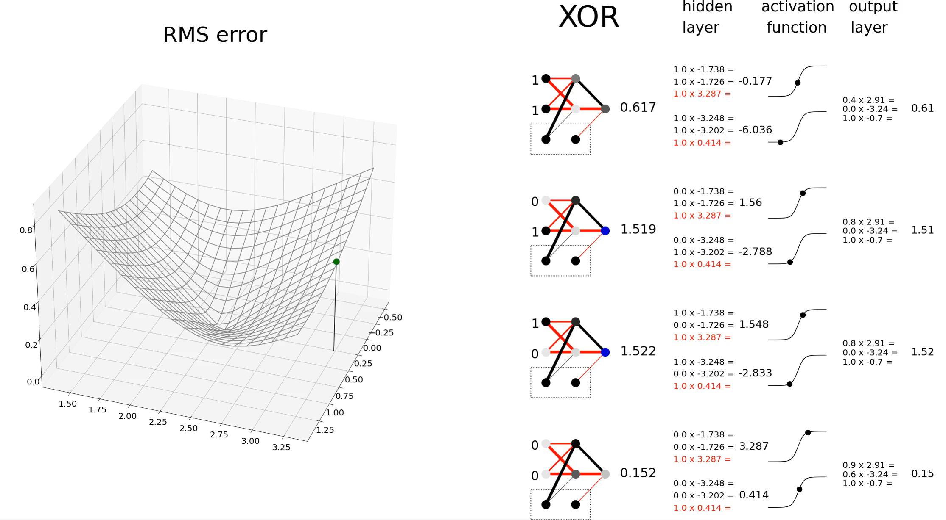

Slide 97


